Slide 1
A Measurement Study of Authentication
Rate-Limiting Mechanisms of Modern Websites
Bo Lu, Xiaokuan Zhang, Ziman Ling,
Yinqian Zhang, Zhiqiang Lin
Dept. of Computer Science & Engineering
The Ohio State University

Slide 2

Introduction
Vulnerable to attacks!
Text-based Passwords
Exist for decades
Used in desktops, phones, websites, …

Slide 3

Introduction
Password Attacks
Offline Attacks
Online Attacks
Notes:
Offline Attack: attacker possesses the password database, password are hashed; can brute-force
Online Attack: guess the correct passwords through web interface. Rate limiting mechanism enforced; Need to solve it within a number of attempts; without being blocked/locked.

Slide 4
Introduction
Solutions to online password attacks:
Account Lockout
Login Throttling
Notes:
multiple unsuccessful login attempts against an account have been detected within a short period,
mechanisms to throttle high-rate login attempts by using CAPTCHA [41] or temporary (e.g., 5 minutes) account lockouts

Slide 5
Introduction
Online password attacks are still possible!
73% passwords cracked within 100 attempts with auxiliary info
[Wang et al., CCS16]
How do websites implement the rate-limiting mechanisms?
Are they secure enough?
Notes:
multiple unsuccessful login attempts against an account have been detected within a short period,
mechanisms to throttle high-rate login attempts by using CAPTCHA [41] or temporary (e.g., 5 minutes) account lockouts

Slide 6
Outline
Methodology
Experiment
Evaluation
Limitation & Discussion
Conclusion

Slide 7
Methodology
Two key questions:
How websites identify logins from the same user?
How many failed login are allowed?
Black-box Model
Notes:
How websites treat multiple login attempts as authentication requests from the same user?
How many times the websites allow the same user to send frequent login attempts without account lockout or login throttling?
black box model
In the context of this paper, we do not distinguish lockout and throttling as they both thwart continuous login attempts from an automated online password cracker.

Slide 8
Methodology
Lockout Threshold
The maximum number of invalid logins from the same user
Counting Mechanism
Methods used to identify multiple logins
from the same user
Login Interval
Interval between consecutive logins from the same user
Notes:
In this paper, we define:
Lockout Threshold: The maximum number of invalid login attempts from the same user that can occur before the account is locked out or throttled
Counting Mechanism: The mechanism with which a website identifies multiple continuous login attempts from the same user

Slide 9
Methodology
Modeling Lockout Threshold: G(itvl) → N
itvl: the time interval between two consecutive logins
N: set of all natural numbers
Only use itvl to represent the rate-limiting implementation
It might oversimplify the real-world design

Slide 10
Methodology
Modeling Counting Mechanism: F (acct, cip, cookie) →{0, 1}
acct: account
cip: client IP address
cookie: cookie in the browser
acct = 0: using the same account
F = 1: recognized by the website
F(1,1,1) = 0
Notes:
the Counting Mechanism has recognized the user as one that has previously attempted to log in but failed

Slide 11
Lockout Threshold (LT) Test: G(itvl) → N
Lockout
Threshold
Interval
Counting Mechanism (CM) Test: F (acct, cip, cookie) →{0, 1}
(acct, cip, cookie)
0 or 1

Slide 12
Outline
Methodology
Experiment
Evaluation
Limitation & Discussion
Conclusion

Slide 13
Experiment
Experiment Setup
Python + Selenium
Azure + Shadowsocks

Slide 14
Experiment
Data Collection
Alexa Top 500 Websites
NIST Guideline;
CCS’16 paper
Website A
Y
Register one account
LT test with itvl=8s
Y
STOP
Feasible?
Thrsh>100?
N
N
ABORT
CM tests
LT tests with larger itvls
Register
7 more accounts

Slide 15
Experiment
Data Collection:
Excluding 318 websites (182 websites left)
Reason | Number of Websites
Have inappropriate content | 24
Use other single sign-on services | 50
Do not have account services | 69
Require sensitive information | 104
Encounter technical issues | 71

Slide 16
Outline
Methodology
Experiment
Evaluation
Limitation & Discussion
Conclusion

Slide 17
Evaluation: Data Analysis
Lockout Threshold
112
80
63
43
itvl = 8s
itvl = 1024s

Slide 18
Evaluation: Data Analysis
Transition Interval: The minimum interval between consecutive password guesses that allows the adversary to continuously login without blocking
20
9
6
3

Slide 19
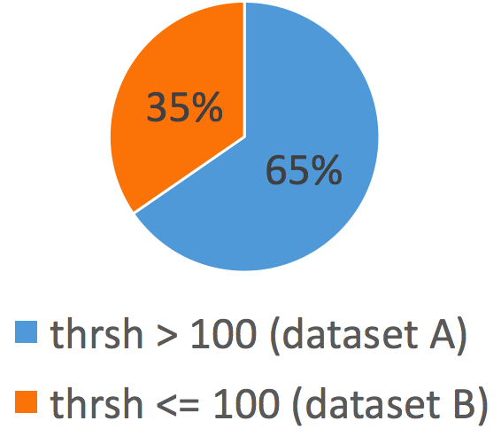
Evaluation: Data Analysis
Lockout Threshold (thrsh) when itvl=8s
Dataset A (63): 35%
Dataset B (119): 65%

Slide 20
Evaluation: Data Analysis
Dataset B (119): Counting Mechanism Test
84
39
3

Slide 21
Evaluation: Data Analysis
Takeaways
112(62%) websites have thrsh > 100 when itvl=1024s
63(35%) websites have a transition interval <= 8s
Changing IP can bypass the mechanism of 39(21%) websites

Slide 22
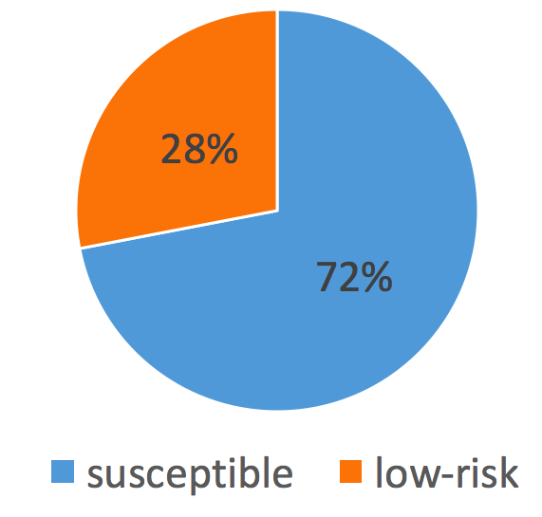
Evaluation: Security Analysis
Lockout Threshold (thrsh) when itvl=1024s
Susceptible (131): thrsh > 100
19: need to change IP
Low-risk (51): thrsh <= 100

Slide 23
Evaluation: Security Analysis
Susceptible websites: Failed login attempts allowed per day
63
6
Notes:
We further estimated how many failed login attempts are allowed per day on the remaining 112 websites that are able to reach thrsh = 100 with a single IP. From the figure, we can learn that there are 63 websites allow more than 10,000 login attempts on single account within 24 hours; 6 websites even permit more than 86,000 attempts on one account within a day.

Slide 24
Evaluation: Security Analysis
Online password guessing in parallel
Archive.org (Transition Interval < 1s)
501
173
110

Slide 25
Evaluation: Security Analysis
Low-risk websites (51)
23 present CAPTCHA
28 lock out the user
Legitimate user attempts will be blocked
Auth-DoS Attack against arbitrary user
Notes:
The second type of low-risk websites lock out the user account
without presenting a CAPTCHA. If so happens, subsequent logins
with correct passwords will also be blocked. The legitimate user
of the account has to go through a series of efforts to recover the
account, such as resetting the password or calling a customer representative.

Slide 26
Evaluation: Security Analysis
Takeaways
131 (72%) susceptible websites (thrsh>100 when itvl=1024s)
28 websites may be vulnerable to Auth-DoS attacks

Slide 27
Outline
Methodology
Experiment
Evaluation
Limitation & Discussion
Conclusion

Slide 28

Limitation
Technical issues in data collection (71 websites)
Cloud IP range blacklisted
Automated login attempts (Selenium) detected
HTTP response slowed down after a few attempts

Slide 29
Limitation
Did not differentiate account lockout and login throttling
Imperfect models for real-world implementations
Threshold may be > 100
Threshold may change dynamically for the same interval

Slide 30
Discussion
Recommendations
Implement counting mechanisms that do not rely on info from the client
Implement rate-limiting mechanism when reach Lockout Threshold (e.g. 2-factor auth)
Enforce strong password

Slide 31
Outline
Methodology
Experiment
Evaluation
Limitation & Discussion
Conclusion

Slide 32
Conclusion
Proposed a black-box approach to modeling the rate-limiting implementations of websites
Presented a systematic measurement study on a subset of Alexa Top 500 websites
Revealed susceptibility of these websites to online password guessing attacks

Slide 33
Thanks for listening!
Xiaokuan Zhang
zhang.5840@osu.edu

Slide 35
Discussion
Responsible Disclosure
131 susceptible websites
15 provide email for reporting security issues
51 require filling out an online form
65 list customer support contacts ONLY
Contacted 15+51 websites, only 3 responded

Slide 36
Discussion
Future Directions
Investigate lockout mechanisms
Method to unlock an account
Whether repeated lockout will trigger alarms
Integrate with CAPTCHA cracking
The difficulty of breaking the CAPTCHAs
How CAPTCHAs affect later logins

Slide 37
Methodology
Blackbox Tests --- Unit Test
UnitTest (Account, IP, Cookie) → {S,W,L}
Success (S), Wrong Password (W) and Locked (L)
UnitTest
(Account, IP, Cookie)
S/W/L

Slide 38
Methodology
Lockout Threshold (LT): G(itvl)
Input: a list of intervals; Output: a list of Lockout Thresholds
Clean State: new account&IP, no cookie, count=0
Clean State
Get New itvl
ret = UnitTest()
Y
Record (itvl, count)
ret = L?
N
N
Stop
Y
count
>100?
wait(itvl);
count+=1

Slide 39
Methodology
Counting Mechanism (CM): F (acct, cip, cookie) →{0, 1}
Input: Thrsh=G(8s), a list of (acct, cip, cookie)
Output: A list of (acct, cip, cookie) that create clean states
Clean State: new account&IP, no cookie, count=0
Y
Clean State
Get new (acct,cip, cookie)
Modify State
ret = UnitTest()
ret = L?
N
N
Record (acct,cip, cookie)
Y
count==
Thrsh?
wait(itvl);
count+=1

Slide 40
Introduction
Measurement study
Highlights of our result:
131 (72%) susceptible websites
63 websites allow >10K failed login per day
19 websites allow unlimited login w. different IP
Notes:
131 out of 182 websites allow frequent, unsuccessful login attempts without account lockout or login throttling

